Slide 1
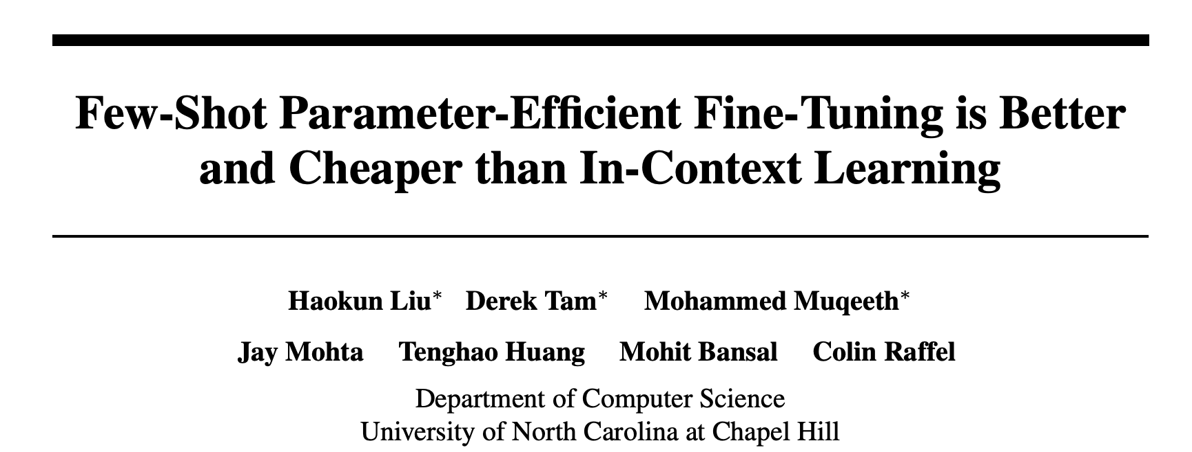
LLM: Few-Shot Fine-Tuning V.S. In Context Learning
Houston Machine Learning Meetup
12/13/2024

Slide 2
LLM Training Paradigm
Task-specific labeled data provided as in-context examples
In-context Learning
(no weights updates)
Meta-Llama-3-70B
Meta-Llama-3-70B-Instruct
Pre-training
Multi-task Instruction Fine-tuning
Aligning with Human Preference
(RLHF)
Fine-tuning (weights updated with PEFT)
Large unlabeled data
(trillions)
Small labeled data from multiple tasks
(millions)
Human preference data
Custom Task-specific labeled data
(tens to thousands)

Slide 3
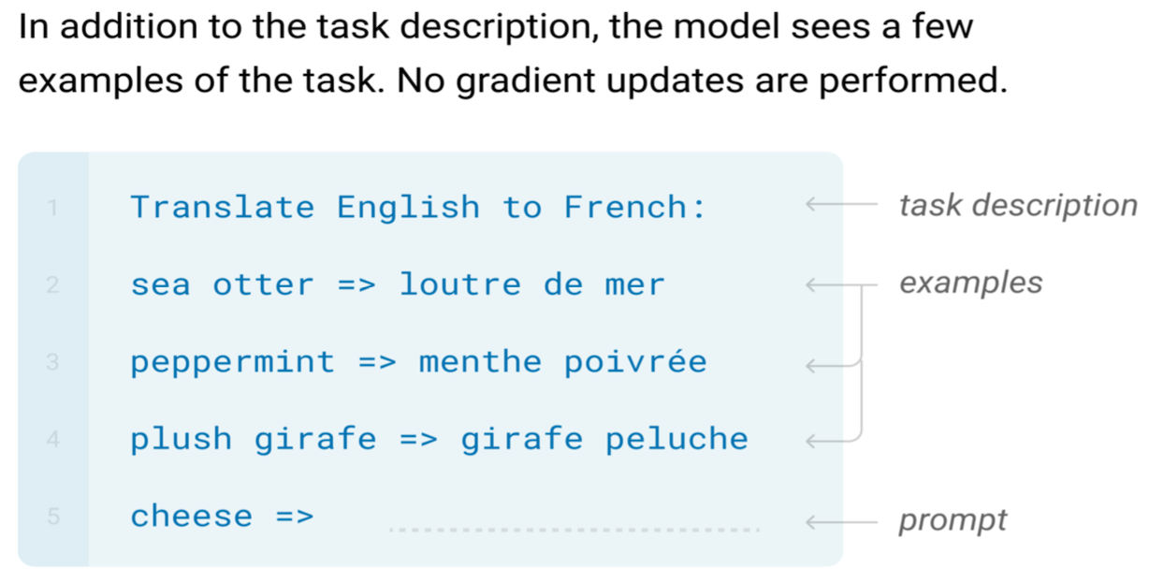
Few-shot In-Context Learning (ICL)

Slide 4
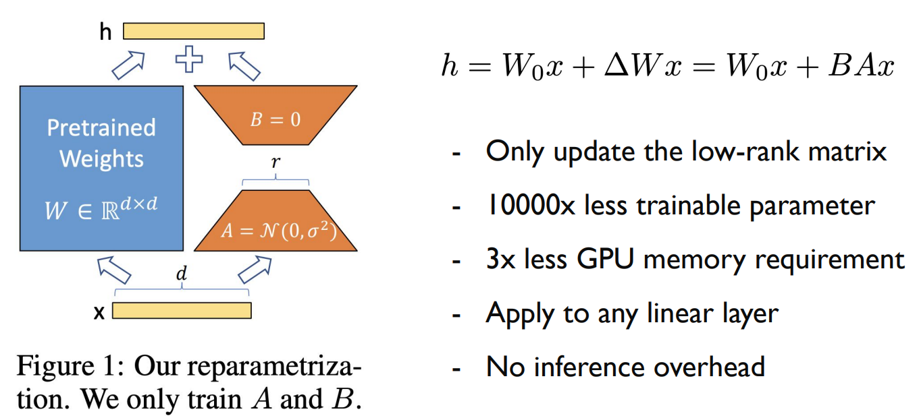
Few-shot Fine-tuning (PEFT)
Fine-tuning is a process that involves adjusting a pretrained model's weights to better fit your specific data or task. This is different from in-context learning, as it actually trains a new model on your custom data.
LoRA parameter-efficient fine-tuning (PEFT)

Slide 5
Comparison: ICL v.s. PEFT
ICL
PROS:
ICL enables single models to perform many tasks without additional training
CONS:
Processing the k in-context examples increases the inference cost by approximately k times compared to processing the unlabeled example alone.
ICL typically produces inferior performance compared to fine-tuning.
The exact formatting of the prompt (including the wording and ordering of examples) can have significant and unpredictable impact on the model’s performance.
PEFT
PROS:
No additional inference cost compared to processing the unlabeled example directly
Have significant better performance comparing to ICL
CONS:
One-time fine-tuning cost to train the model

Slide 6
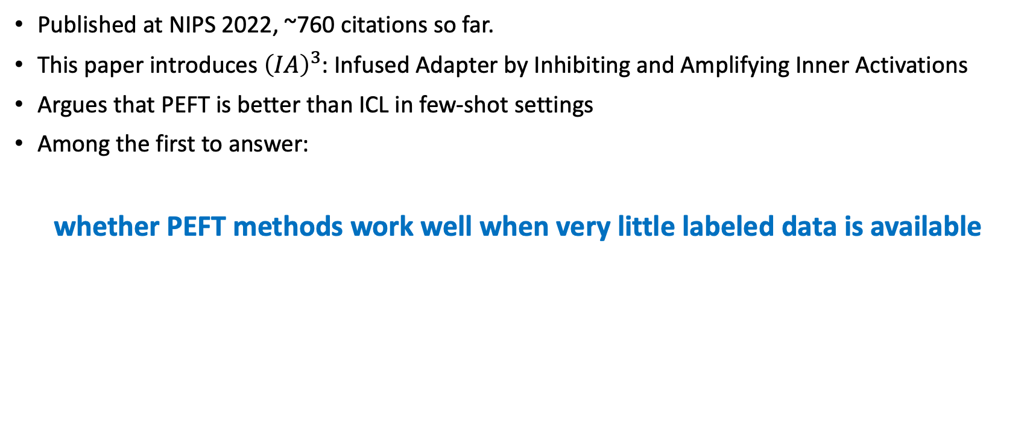
Published at NIPS 2022, ~760 citations so far.
This paper introduces ${\left(IA\right)}^{3}$: Infused Adapter by Inhibiting and Amplifying Inner Activations
Argues that PEFT is better than ICL in few-shot settings
Among the first to answer:
whether PEFT methods work well when very little labeled data is available

Slide 7
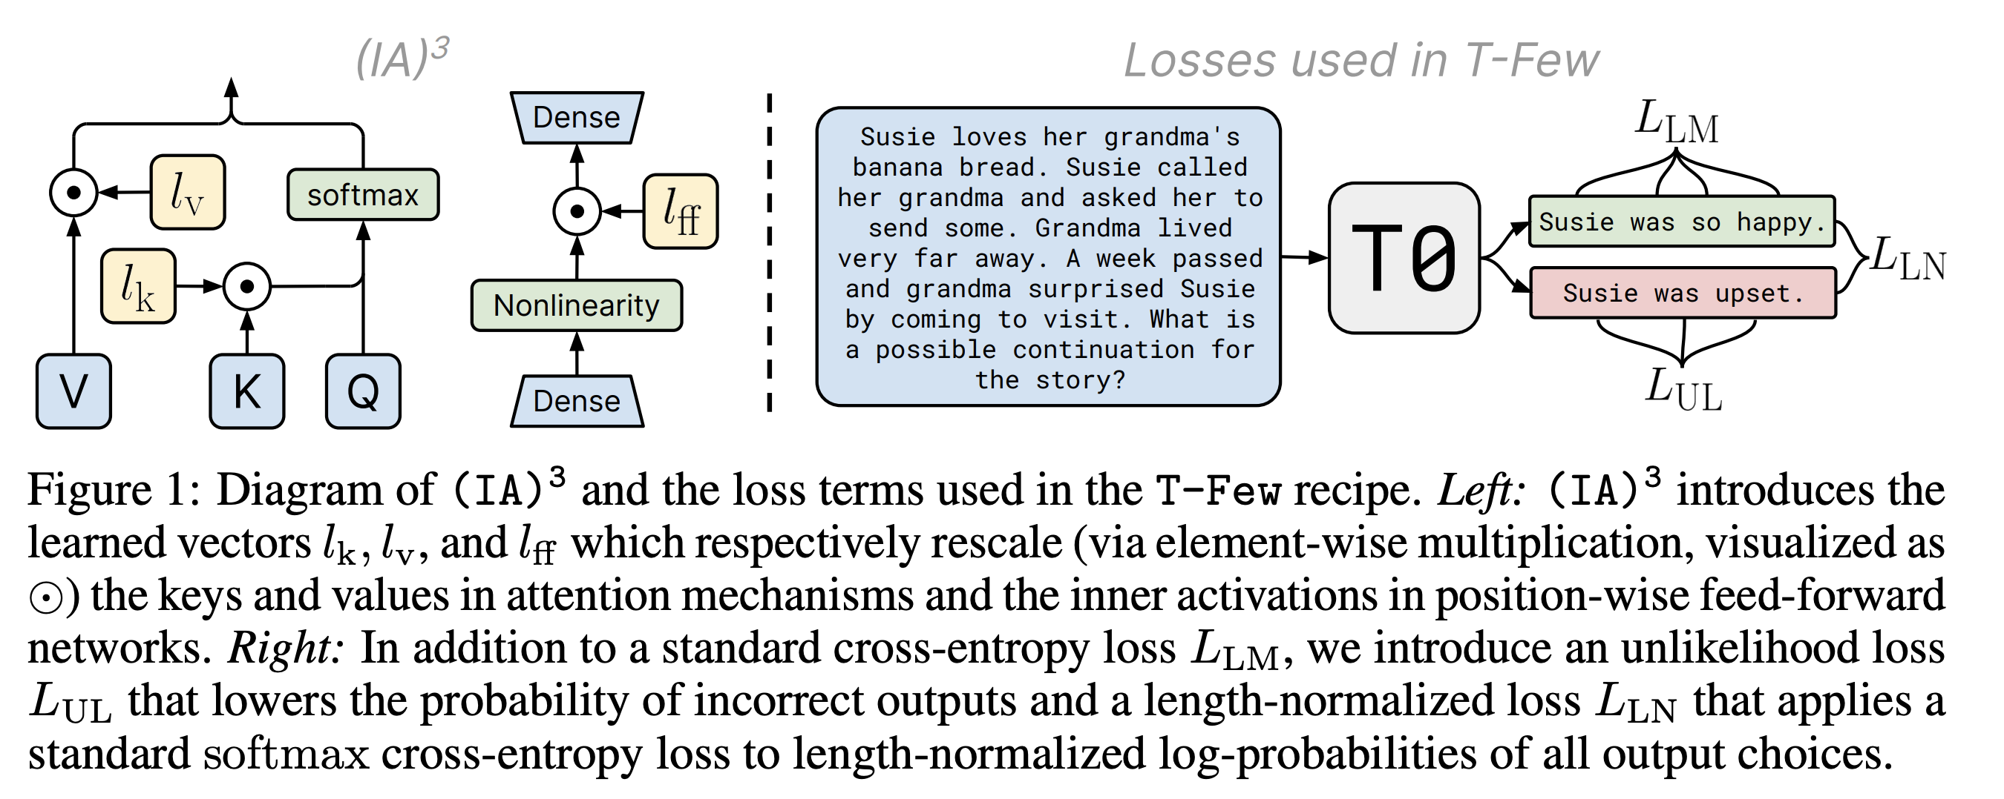
Overview
(IA)3: “Infused Adapter by Inhibiting and Amplifying Inner Activations”

Slide 8
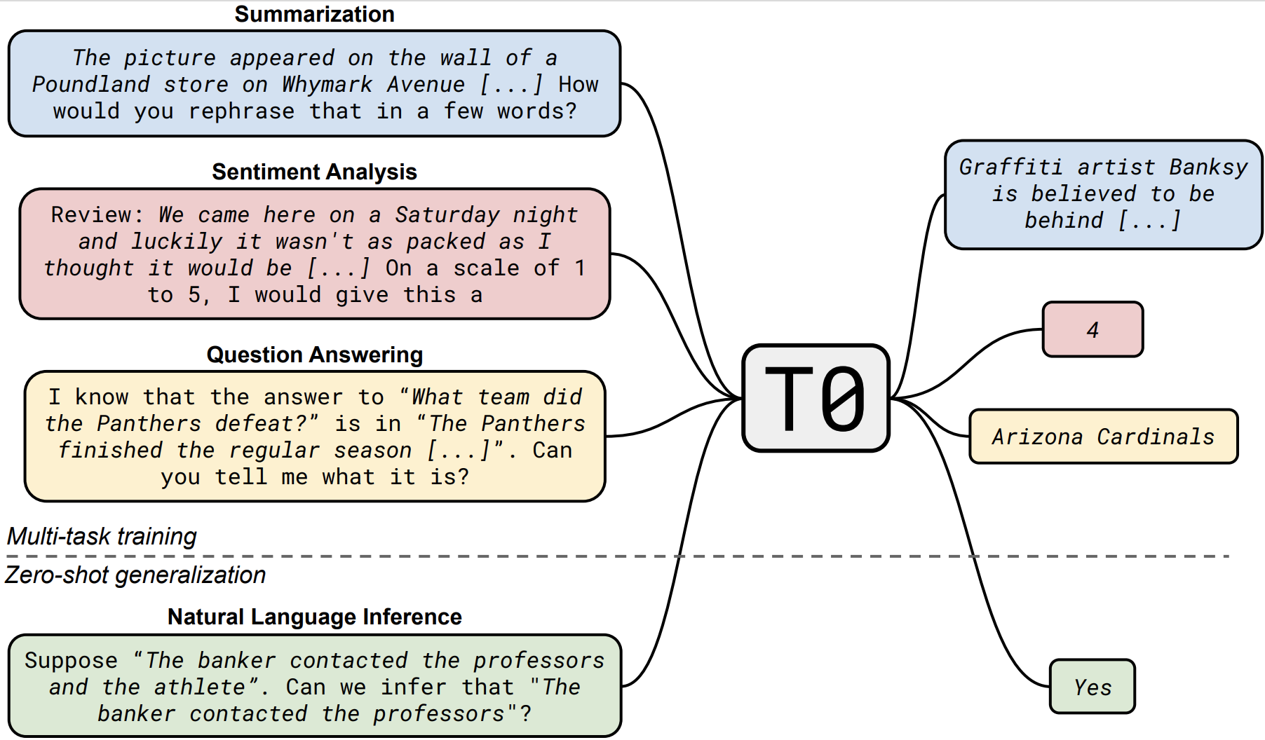
Choose a pre-trained model: T0

Slide 9
Choose a pre-trained model: T0
T0 is based on T5, an encoder-decoder Transformer model that was pre-trained via a masked language modeling objective on a large corpus of unlabeled text data.
T0 was created by fine-tuning T5 on a multitask mixture of datasets in order to enable zero-shot generalization, i.e. the ability to perform tasks without any additional gradient-based training.
T0 was released in 3B and 11B parameter variants, referred to as “T0-3B” and simply “T0” respectively
T0 shows zero-shot task generalization on English natural language prompts, outperforming GPT-3 (175B) on many tasks, while being 16x smaller.

Slide 10
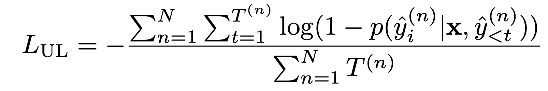
Model loss: Unlikelihood loss
We discourage the model from predicting tokens from incorrect target sequences, where ^y (n) = (ˆy1(n), ^y2(n), . . . , yˆT(n) ) is the n-th of N incorrect target sequences.

Slide 11
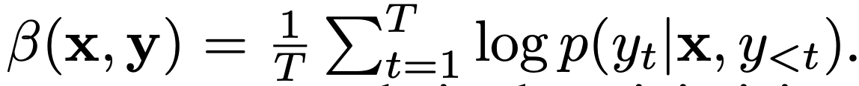
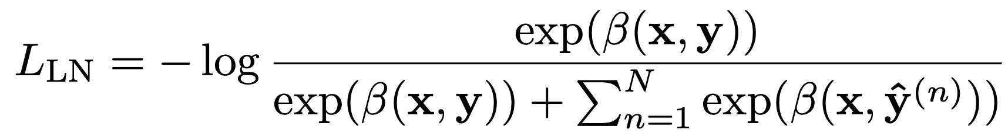
Model loss: Length Normalization
we maximize the length-normalized log probability of the correct answer choice

Slide 12
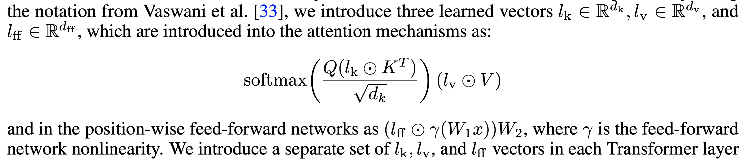
Model PEFT: Recaling vectors
We found it was sufficient to introduce rescaling vectors on the keys and values in self-attention and encoder-decoder attention mechanisms and on the intermediate activation of the position-wise feed-forward networks.

Slide 13
Comparisons with other PEFT methods
We compare with 9 strong PEFT methods:
BitFit: updates only the bias parameters
Adapters: introduce task-specific layers after the self-attention and position-wise feed-forward network
Compacter and Compacter++: improve upon adapters by using low-rank matrices and hypercomplex multiplication
Prompt tuning: learns task-specific prompt embeddings that are concatenated to the model’s input
FISH Mask: chooses a subset of parameters to update based on their approximate Fisher information
Intrinsic SAID (Structure-aware intrinsic dimension): performs optimization in a low-dimensional subspace
Prefix-tuning: learns task-specific vectors that are concatenated to the model’s activations
LoRA: assigns low-rank updates to parameter matrices.
Additionally, we include the baselines of full-model fine-tuning.

Slide 14
Evaluation
Evaluation is done using the T0 Model
For each dataset tested, the number of few-shot examples used varies from 20 to 70, matching the same numbers as the evaluation from the paper: “Language models are few-shot learners” focusing on few-shot in context learning.

Slide 15
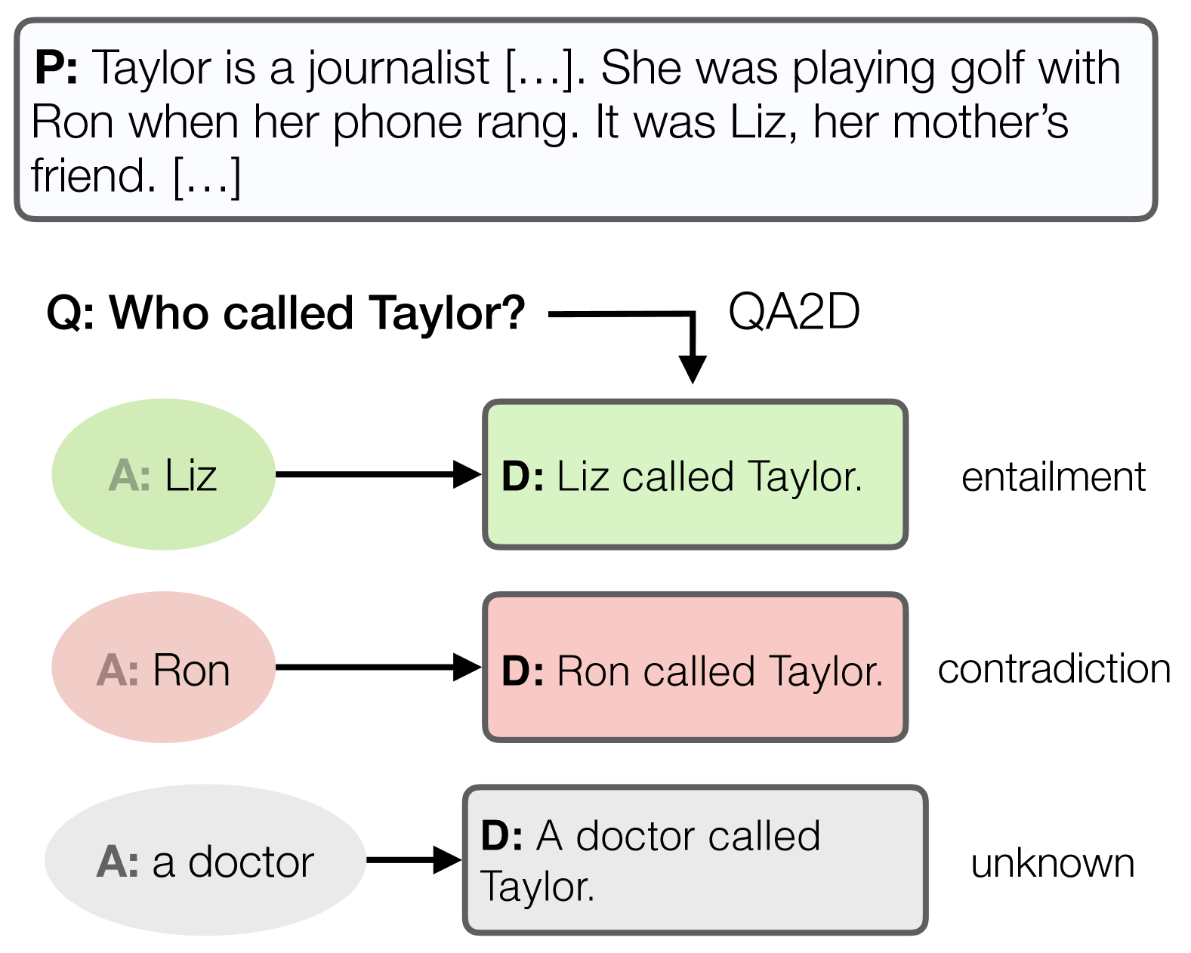
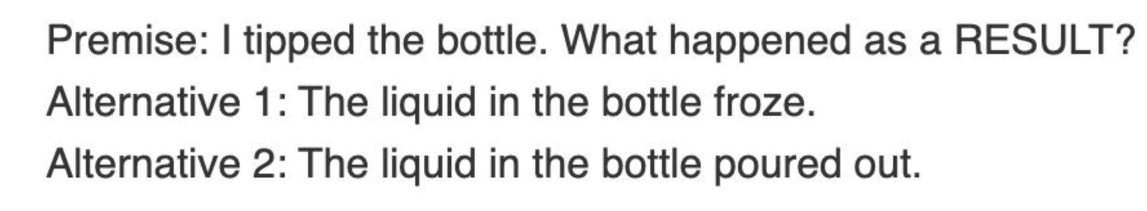
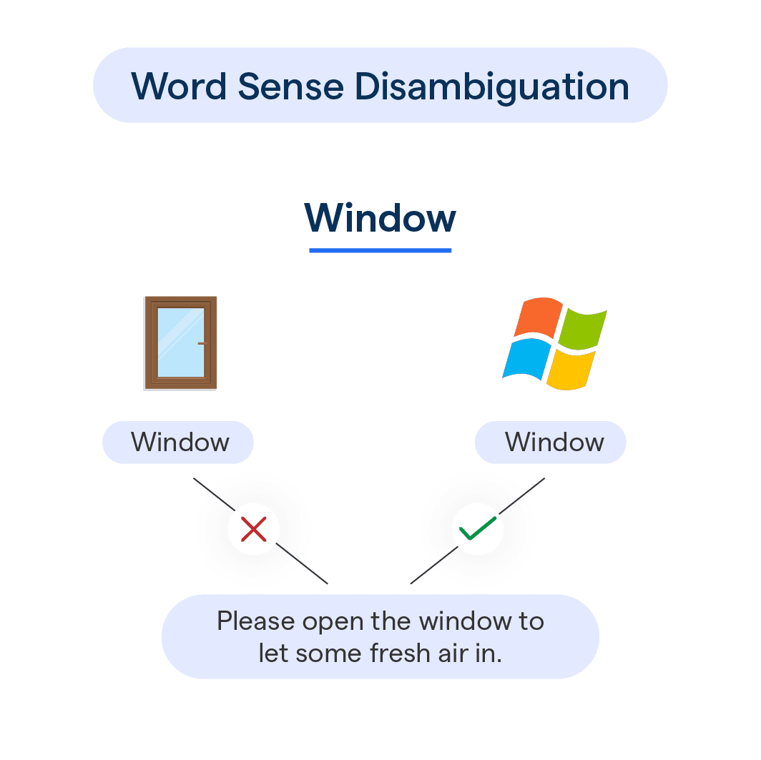
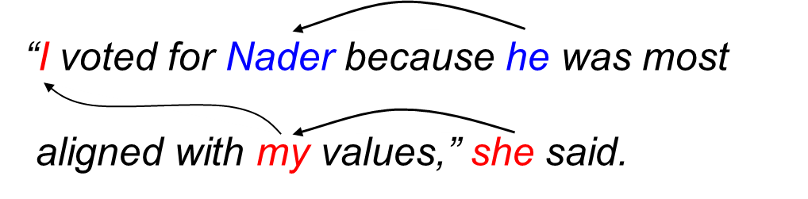
Evaluation Datasets
Datasets used for testing are sentence completion (COPA, H-SWAG, and Story Cloze), natural language inference (ANLI, CB, and RTE), coreference resolution (WSC and Winogrande), and word sense disambiguation (WiC).
Natural Language Inference
Sentence Completion
Coreference Resolution
Word Sense Disambiguation

Slide 16
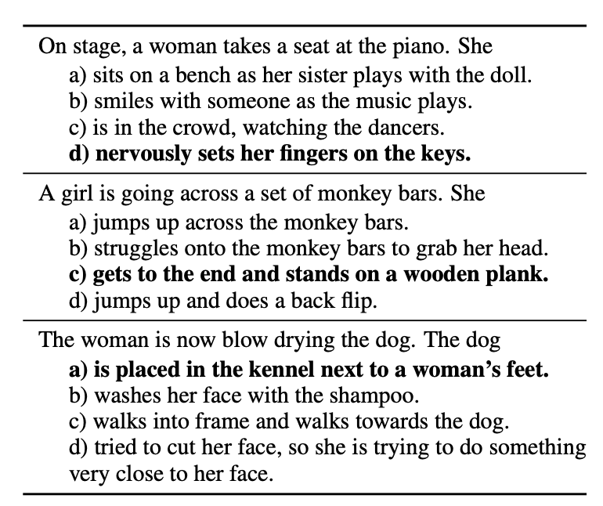
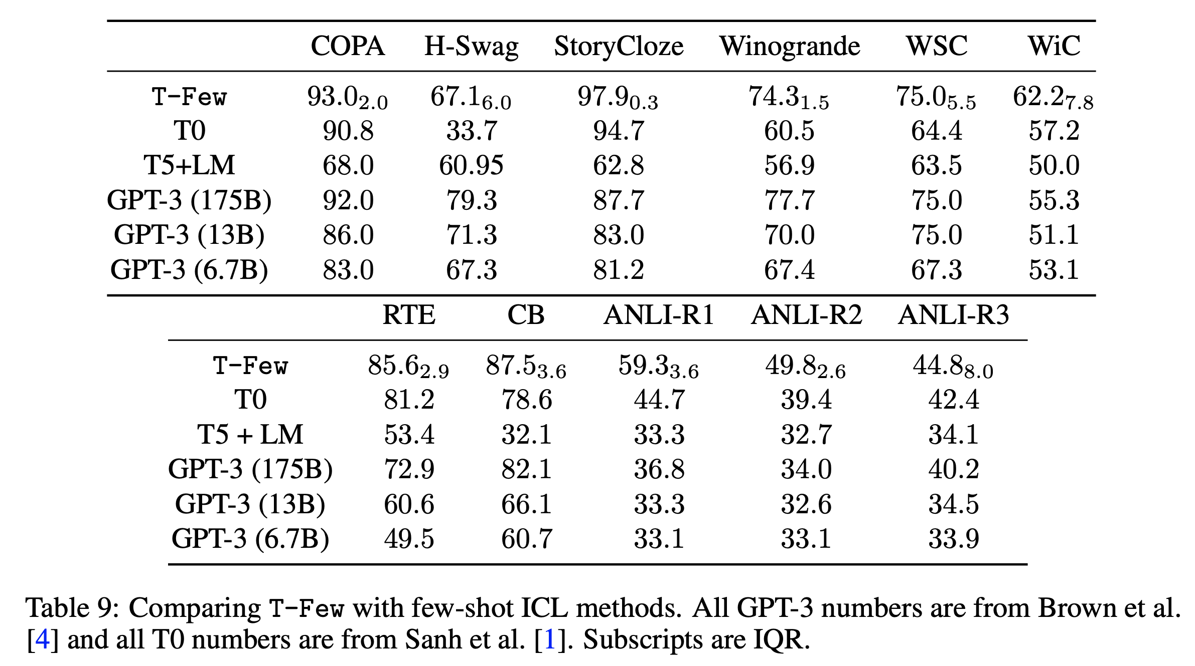
Results
Situations With Adversarial Generations

Slide 17
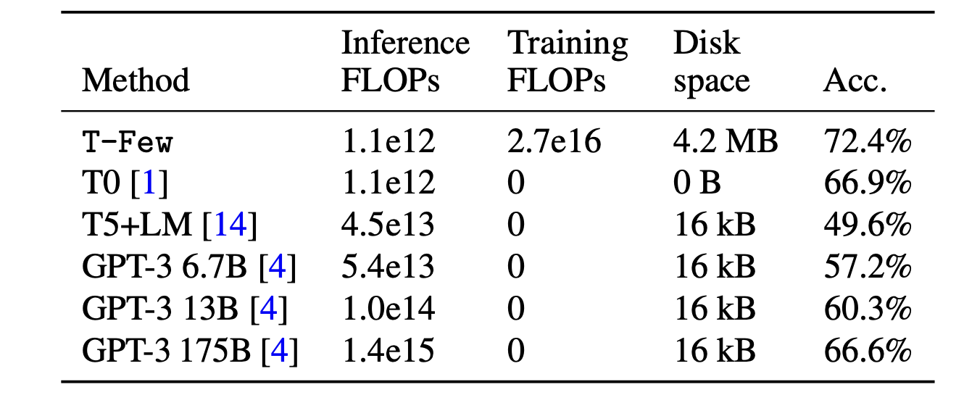
T-Few shine in Inference Cost
The T-Few method shines in terms of Inference FLOPS
Inference FLOPs listed are FLOPS to make a prediction for a single example
T-Few training costs is as much as using GPT-3 175B to process 20 inferences with few-shot ICL.

Slide 18
Training cost is not as big as you thought
Training an eleven billion parameter encoder-decoder model for 1,000 steps with a batch size of 8 length-103 sequences requires approximately 3 × 11e9 × 1, 000 × 8 8 × 103 = 2.7e16 FLOPs.
While not insignificant, this is only about 20 times larger than the FLOPs required to process a single example with few-shot ICL using GPT-3 175B.
Training T-Few costs as much as using GPT-3 175B to process 20 examples with few-shot ICL.
We also found that fine-tuning T0 with T-Few on a single dataset only takes about half an hour on a single NVIDIA A100 GPU. As of writing, this would cost about $2 USD using Microsoft Azure.

Slide 19
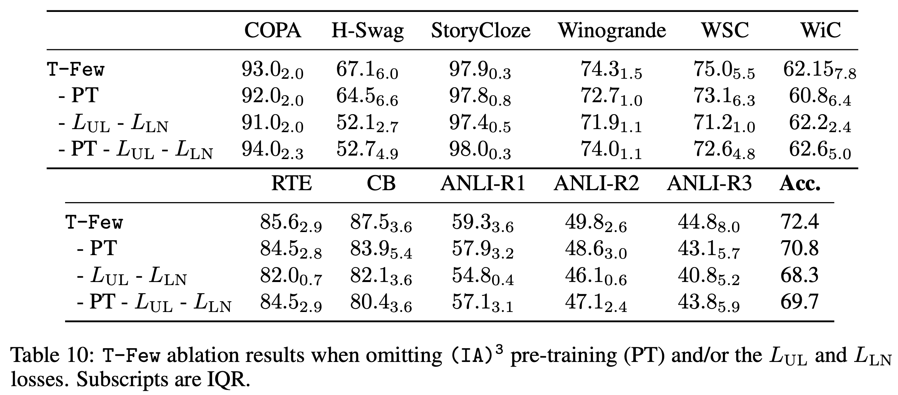
Ablation study on the effects of pre-training (PT) and losses
PT: simply pre-train the new parameters introduced by (IA)3 on the same multitask mixture used to train T0

Slide 20
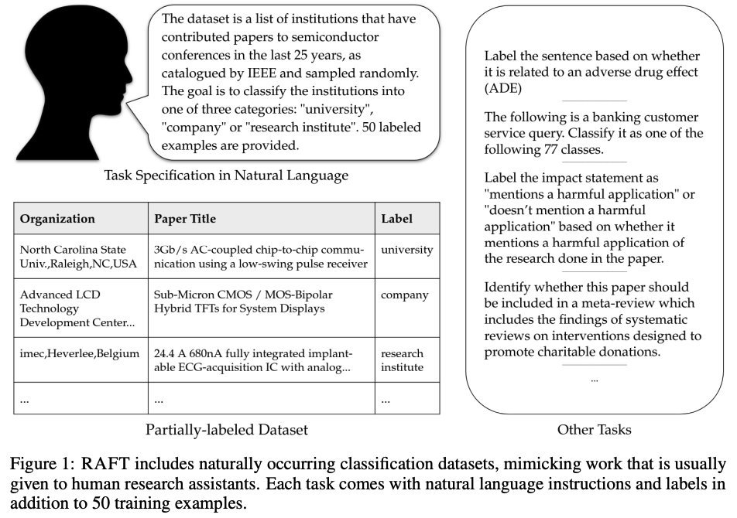
RAFT benchmark: Real-world Annotated Few-shot Tasks

Slide 21
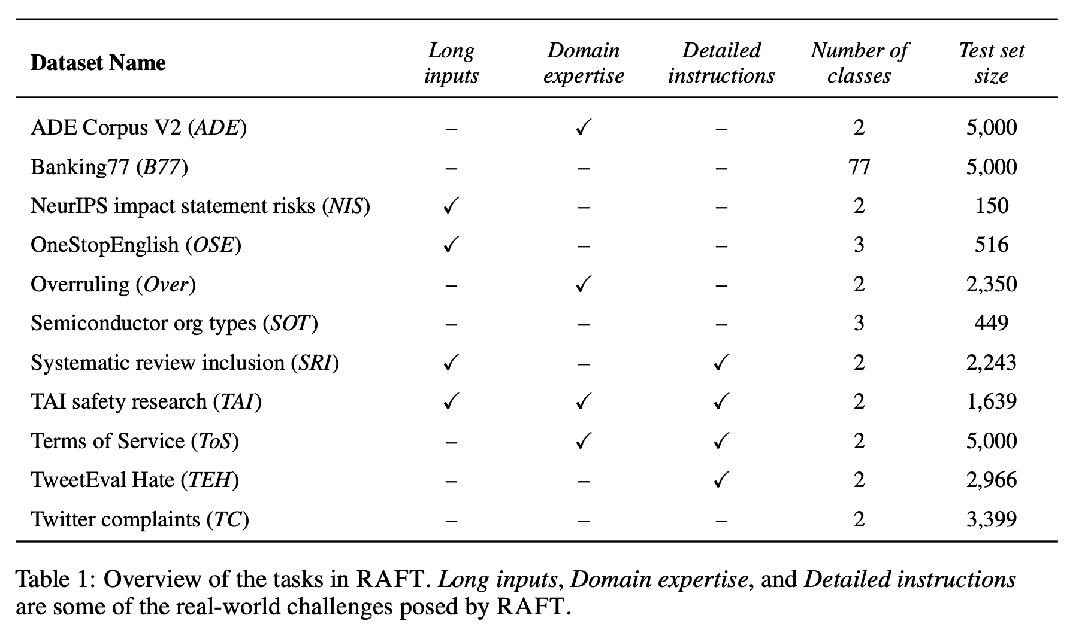
RAFT benchmark: Real-world Annotated Few-shot Tasks

Slide 22
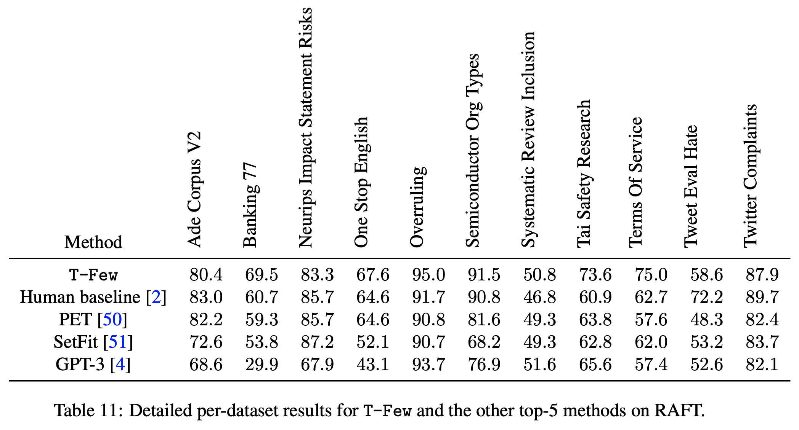
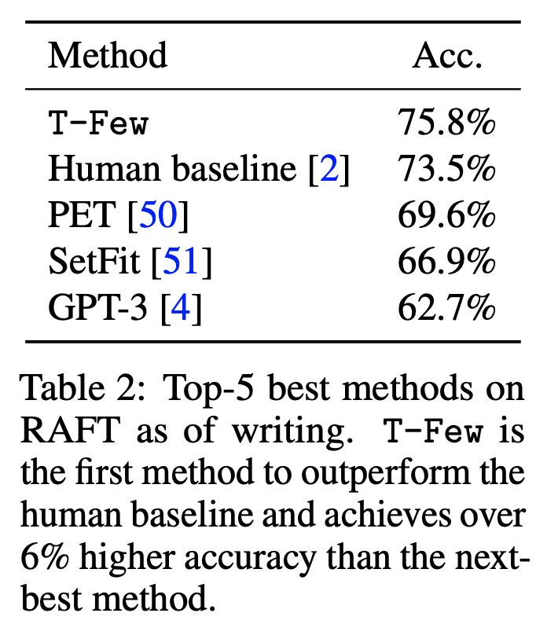
RAFT results
To collect human baselines, we use the Surge crowdsourcing platform. We randomly select 100 data points from each test set and use a 2-step labeling process: qualification then annotation. The crowdsourced label is the plurality vote of 5 labelers.
Metric: Macro-average F1

Slide 23
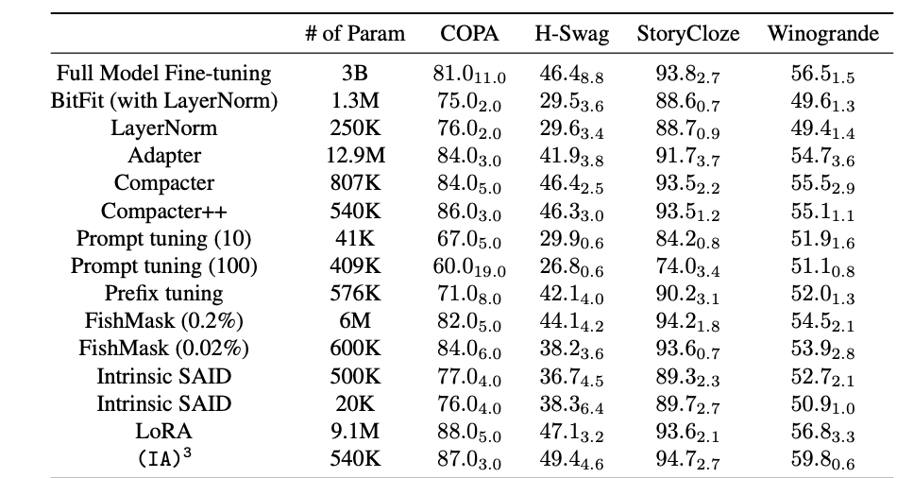
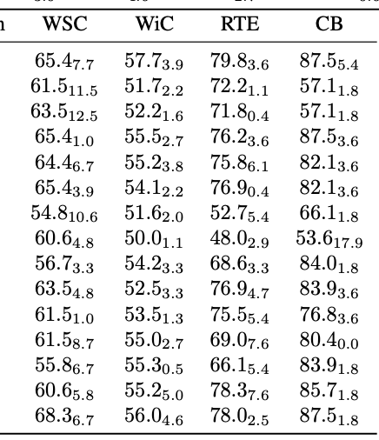
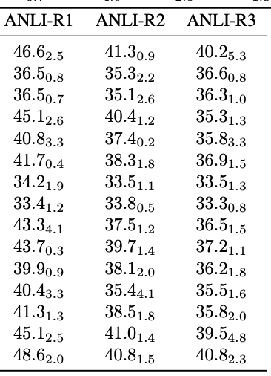
RAFT: Comparison to other PEFT methods

Slide 24
Conclusion
We introduced T-Few, a parameter-efficient few-shot learning recipe that attains higher accuracy than few-shot ICL at a lower computational cost and provide a new perspective on how best to perform few-shot learning with large language models
When applying T-Few to the RAFT benchmark, we attained super-human performance for the first time and outperformed prior submissions by a large margin.
T-Few reduces inference cost with not-so-big one-time training cost: uses over 1,000× fewer FLOPs during inference than few-shot ICL with GPT-3 and only requires 30 minutes to train on a single NVIDIA A100 GPU (equivalent to 20 GPT-3 inference calls)
Caveat: all of the experiments were on multiple choices, classification tasks, we are interested in applying T-Few to generative tasks like as summarization and question answering in future work.

Slide 25

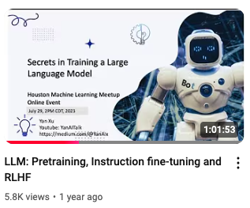
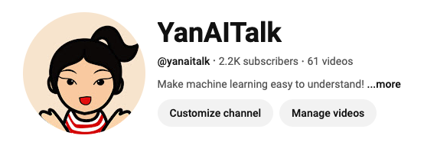
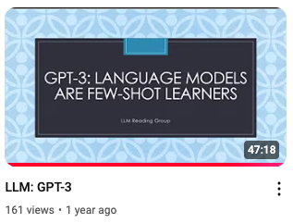
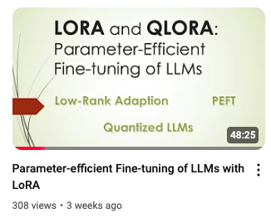
Thank you

